Slide 1
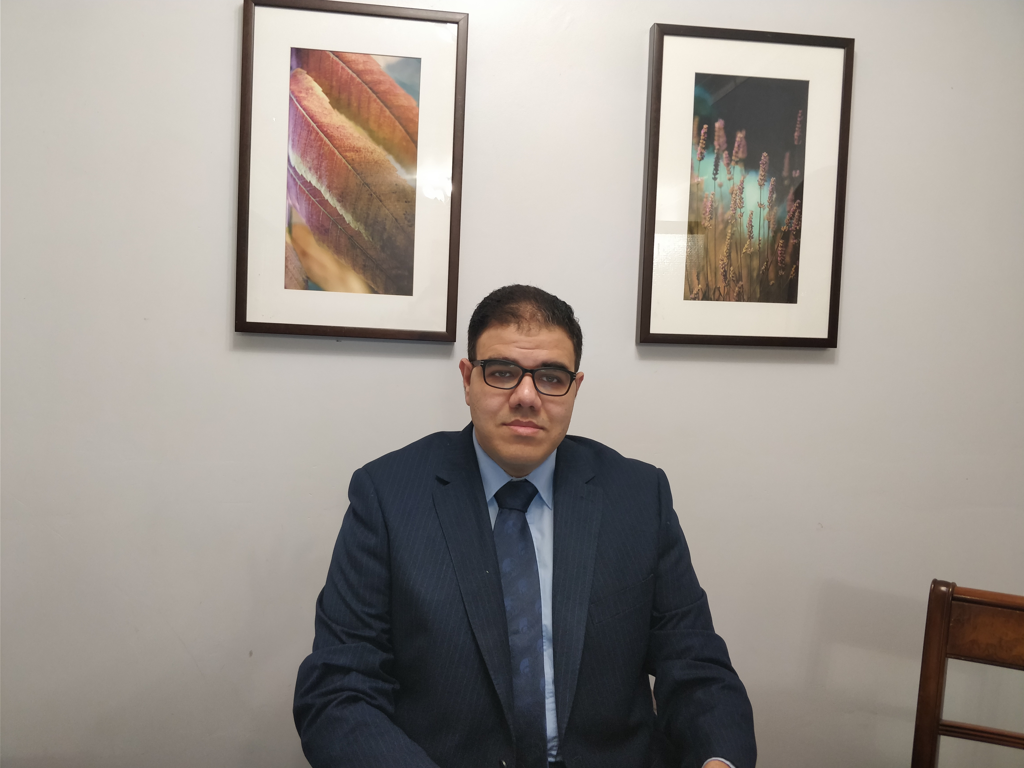
Urinary incontinence
Mohamed Elnasharty
Consultant Obstetrics and Gynecology

Slide 2
Urinary incontinence
Indications for referral to Local MDT
Indications for referral to regional MDT
Assessment
Types of UI
Urodynamics
Management

Slide 3
Referral
Local MDT
Regional MDT

Slide 4
Assessment
Haematuria
Dysuria and bladder pain together with overactive bladder symptoms
Continuous severe UI.
UI associated with voiding symptoms and decreased bladder sensation
Storage symptoms in association with abdominal distension and pain
Onset
Other symptoms of commonly coexisting conditions

Slide 5
Medical history:
Neurological disorder
Diabetes
CHF
Impairment of mobility
Radiotherapy
Drug history
Surgical history
Obstetric and gynaecology
Social

Slide 6
Examination
General
Abdominal
Pelvic
Neurological

Slide 7
Investigations
Urine dip
PVR
Bladder diary
Urodynamics
Indications

Slide 8
Management
Conservative
Lifestyle
Pelvic floor muscle training
Pessary
Medical management
Surgical mangement

Slide 9
Medical management for OAB
Anticholinergic
Mirabegron
Desmopressin
Doluxeitine

Slide 10
Surgical management OAB
BOTOX
PTNS
Percutaneous sacral nerve stimulation
Augmentation cystoplasty
Urinary diversion

Slide 11
Surgical management of SUI
Colposuspension (open or laparoscopic) or
Autologous rectus fascial sling.
Retropubic mid-urethral mesh sling
Intramural bulking agent
Artifical sphincter
Failed surgery

Slide 12
Any questions
Please feel free to contact me: dr.nisho@live.co.uk

